Slide 1
Website of Hot Cuisine
Submitted by:
Mohd Afzal 00220907217 Aabid Hasan 00120902716
Aamir Hussain 00120907217 Akshay Kumar 00320902716

Slide 2
Introduction
In this project, we have designed a static website of a restaurant, named “Hot Cuisine”
The purpose of this project is to provide knowledge of a particular restaurant (i.e. Hot Cuisine) to the visitors. They can be able to view about our restaurant, address of our restaurant, contact no and Our menu and our team as well from anywhere at any time.

Slide 3
It provides a platform to the users, where they can gain all the information about that restaurant.
It is a platform that can be used when someone wants to check the menu, the address or to know about the team of that restaurant.
To provide the ease in searching for dishes, Menu is categorized in different classes of dishes, like Starter, Drinks, Dessert, Gym freak etc.

Slide 4
Roles of User
User can be the visitor who wants to know about the dishes of different varieties, and if he likes any of them, then he can visit the restaurant.
If he likes the menu, and interested in the menu dishes, he can visit to us.
User can get the address, and contact no of the restaurant.
User can know about our team as well.

Slide 5
Basic Idea
The basic idea to develop this website is, to provide a platform where anyone can access all the information about that restaurant from anywhere.
Users can also be able to check our menu before visit there. The menu is categorized in different types of dishes.
If the user is interested in the menu dishes, then he can visit to the restaurant.

Slide 6
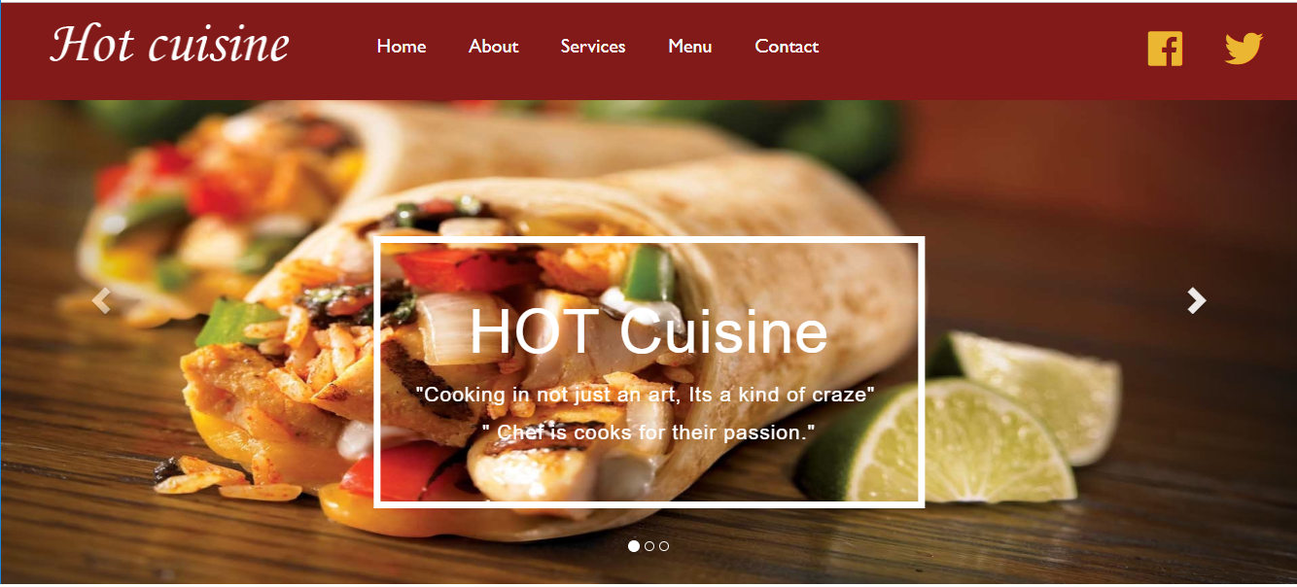
Home Page

Slide 7
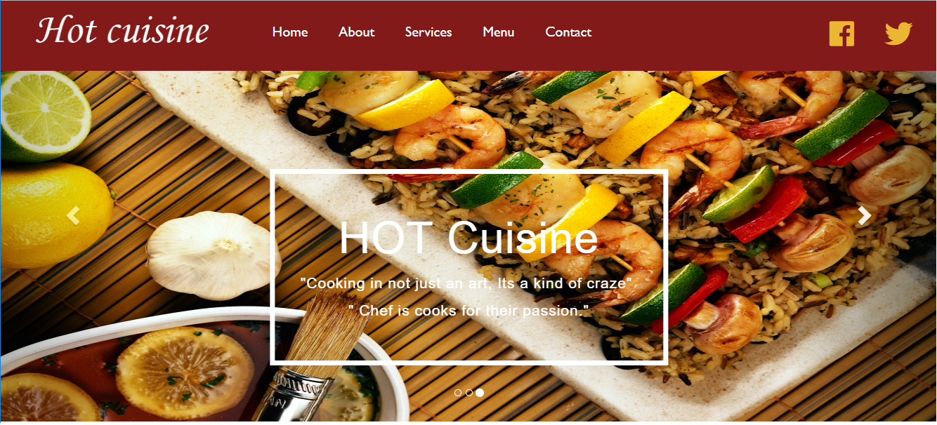
Slider Images on Home Page

Slide 8
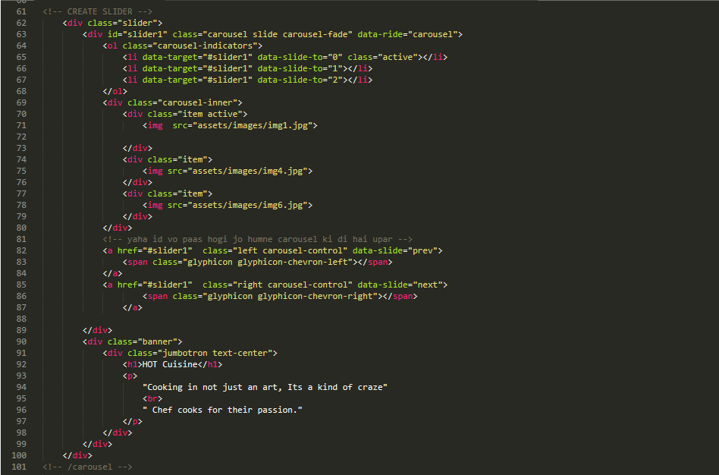
Code for slider

Slide 9
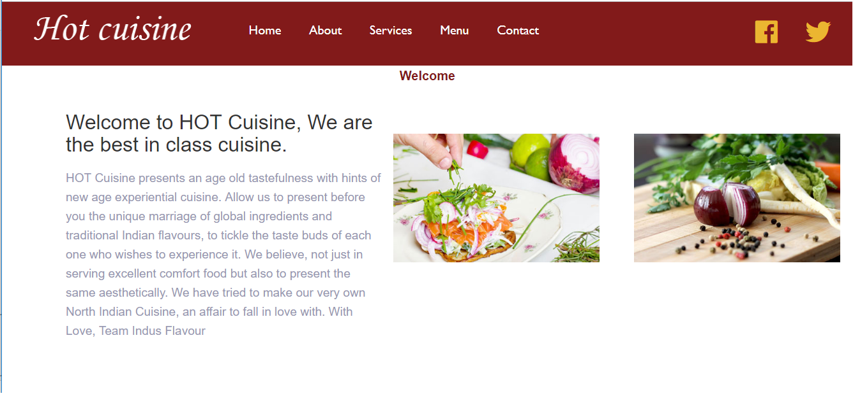
Welcome Note

Slide 10
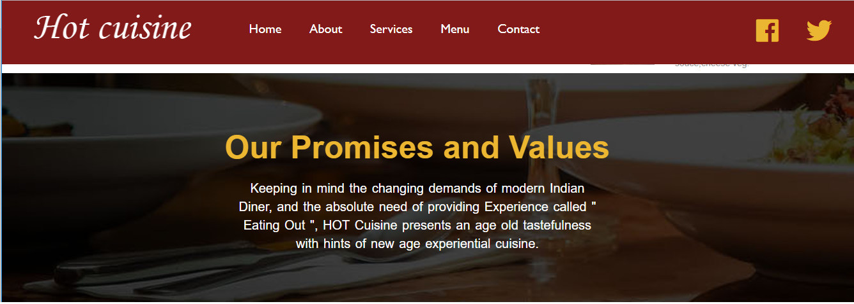
Our Promises and Values

Slide 11
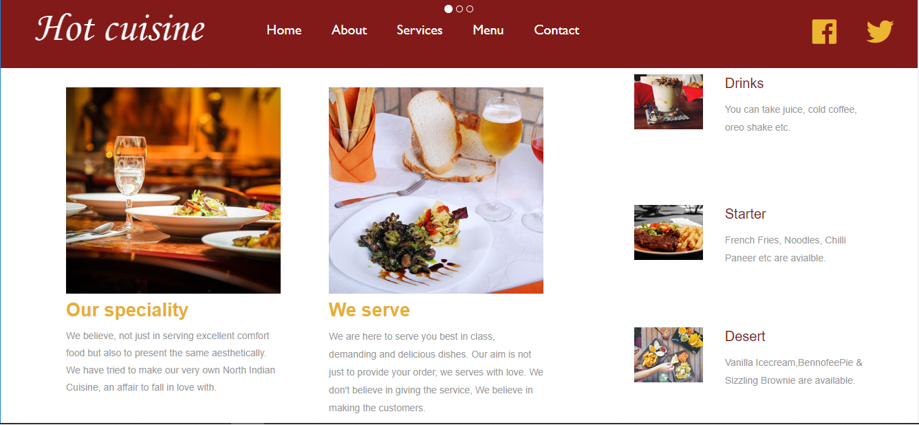
Our Speciality and way of service

Slide 12
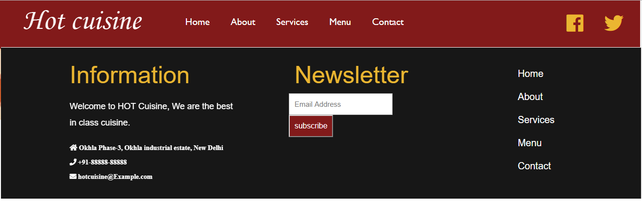
About the restaurant

Slide 13
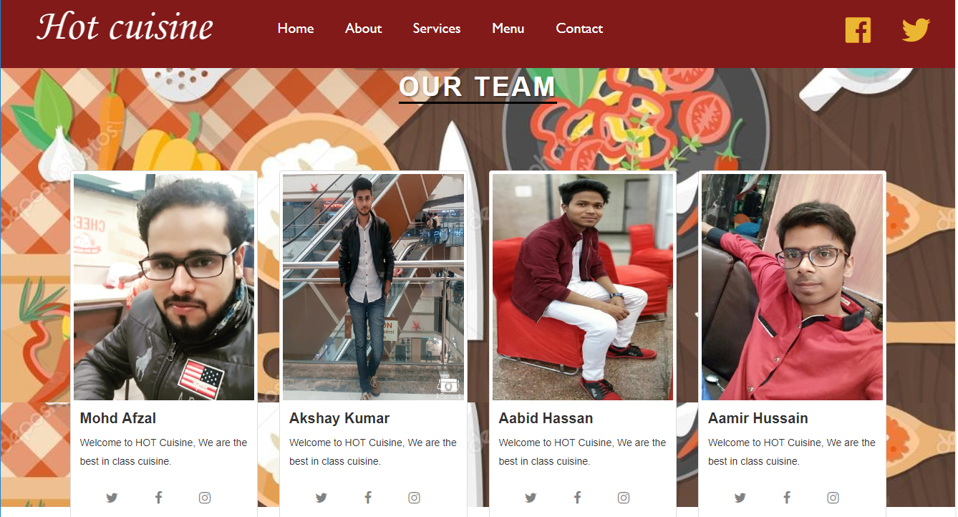
Our Team

Slide 14
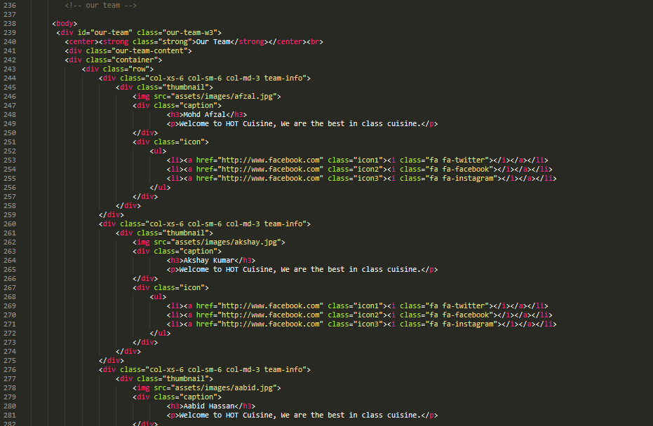
Code for Our team participant

Slide 15
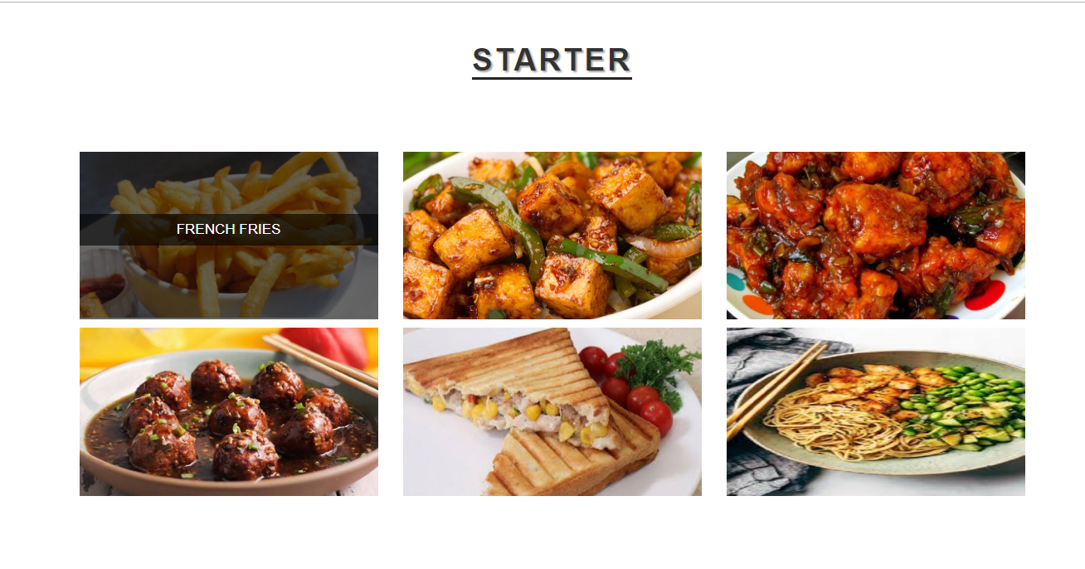
Menu : Starter Dishes

Slide 16
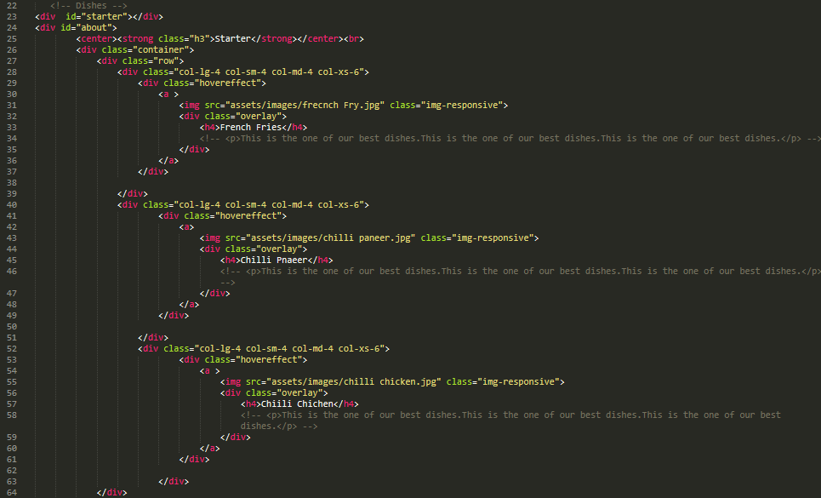
Code for Menu Items

Slide 17
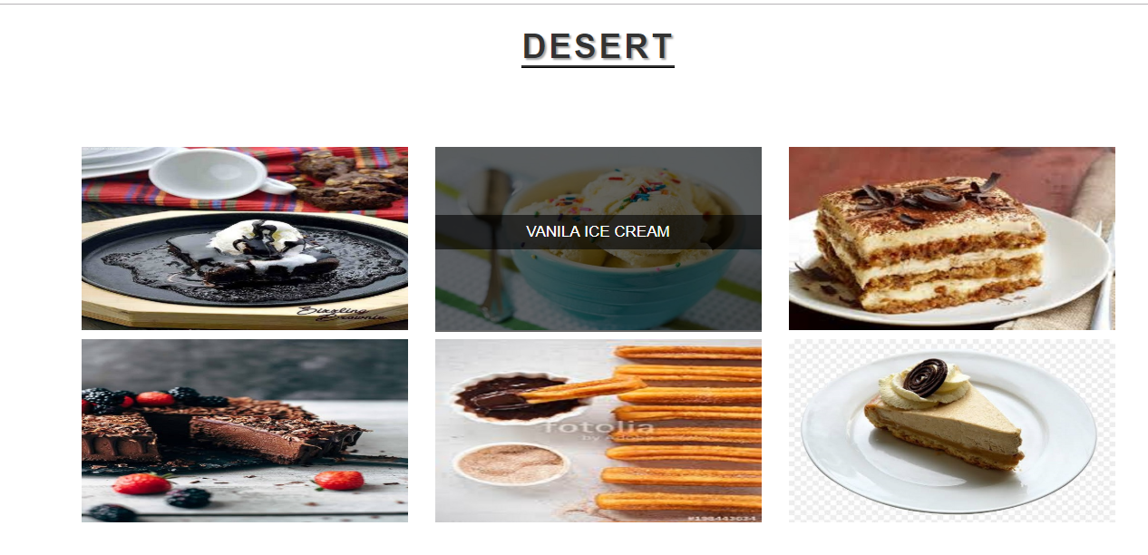
Menu : Desserts

Slide 18
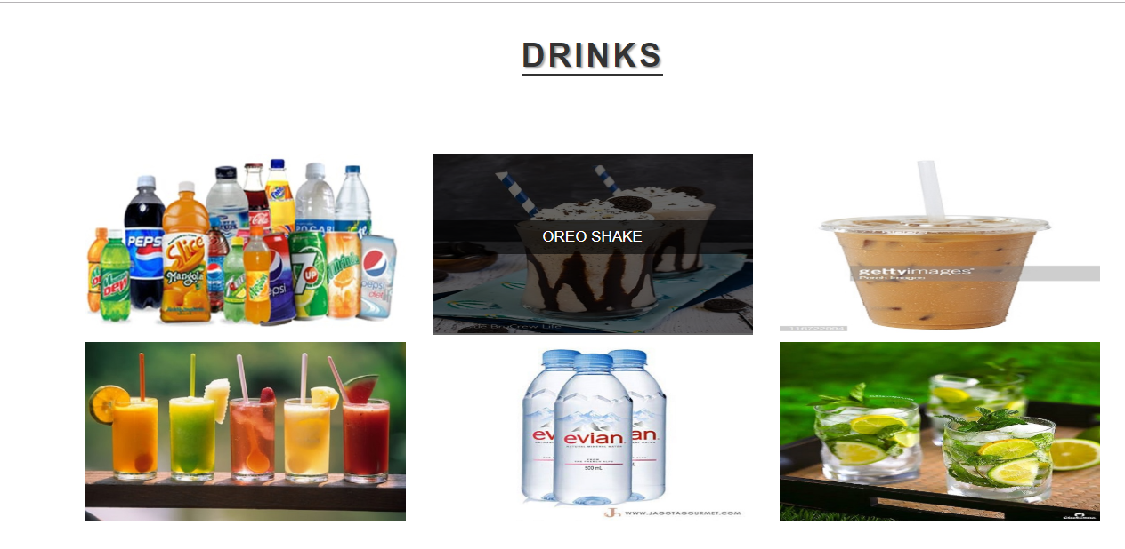
Menu : Drinks

Slide 19
Thank you
For your attention

